Slide 1
Automatic Sanitizer Dispenser

Slide 2
INDEX
Literature survey
Block diagram
Circuit diagram
Work plan
Mechanism
Advantages
Applications
Conclusion
References

Slide 3
Automatic sanitizer Dispenser
1. The Automatic Sanitizer Dispenser is an infrared motion sensor-based dispenser.
2. It used to dispense any alcohol-based sanitizer.
3. It has a touch-less operation, which makes people fearless and more confident about the sanitization process.
4. It is also known as a touch-less or contact-less sanitizer dispenser.
Hand sanitizer-
It is a liquid, gel or foam generally used to kill the vast majority of viruses/bacteria/microorganisms on the hands.
.
.

Slide 4
LITERATURE SURVEY
John M. Boyce, M.D.and Didier Pittet, M.D talked about the significance of hand washing with individual cleanliness. For ages, hand washing with cleanser and water has been viewed as a proportion of individual cleanliness. The idea of purging hands with a germicide specialist most likely rose in the mid nineteenth century. As ahead of schedule as 1822, a French drug specialist exhibited that arrangements containing chlorides of lime or soft drink could destroy the foul smells related with human bodies and that such arrangements could be utilized as disinfectants and sterilizers. In a paper distributed in 1825, this drug specialist expressed that doctors and different people going to patients with infectious illnesses would profit by soaking their hands with a fluid chloride arrangement.
.

Slide 5

R. Monina Klevens, et al., used a multi-step approach and three data sources. The main source of data was the National Nosocomial Infections Surveillance (NNIS) system, data from 19902002, conducted by the Centers for Disease Control and Prevention. Information from the National Hospital Discharge Survey (for 2002) and the American Hospital Association
Survey (for 2000) were utilized to enhance NNIS information. The level of patients with a HAI whose passing was resolved to be caused or connected with the HAI from NNIS information was utilized to gauge the quantity of passing.

Slide 6
COMPONENTS
Arduino Uno (any version)
HC-06 Ultrasonic Sensor
Servo Motors
Jumper Wires
On-Off switch
Battery

Slide 7
Block Diagram
Ultrasonic sensor
Servo motor1
Servo motor2
Arduino

Slide 8
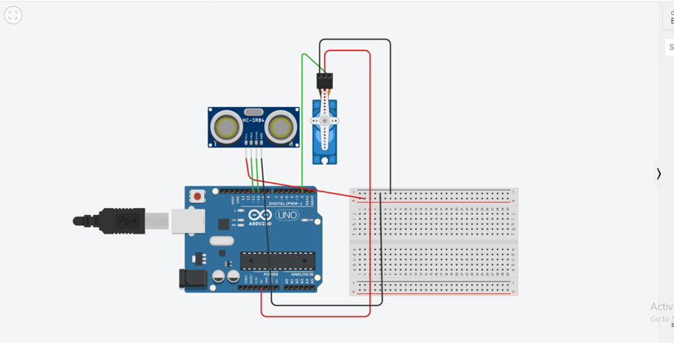
Circuit Diagram
ultrasonic distance sensor
Servo Motor
breadboard
Arduino

Slide 9
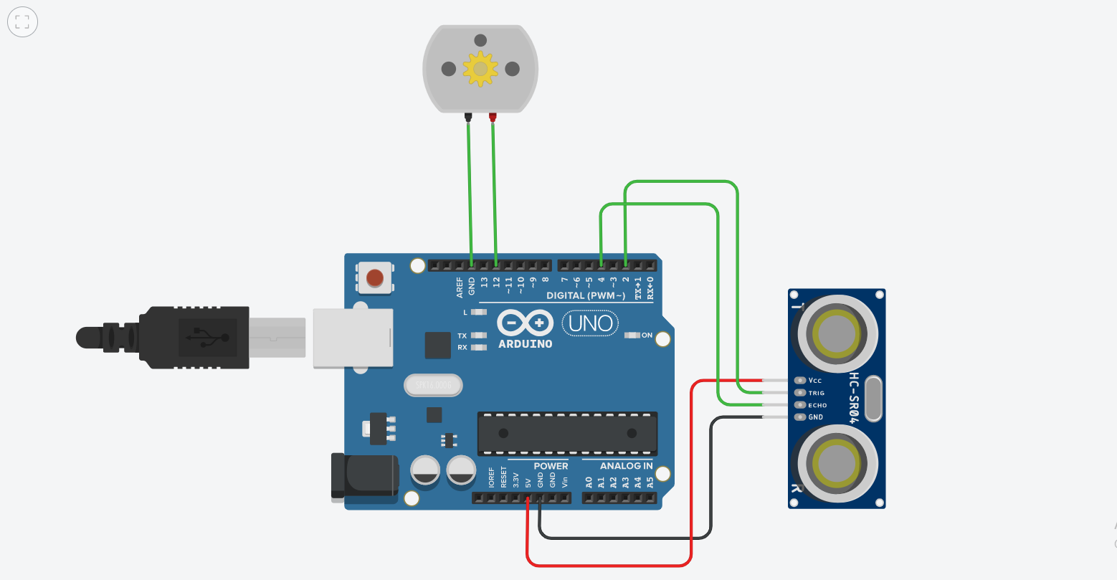
Modified Circuit Diagram
DC Motor
Arduino
ultrasonic distance sensor

Slide 10
working
when we place our hand in front of the automatic sanitizer dispenser there is a sensor place at the dispenser and it will detect your hand in front of the sensor and then the will dispense in your hand.
There is an ultrasonic sensor which works on the ultrasonic waves. There is a transmitter and the receiver in the ultrasonic sensor which transmit the ultrasonic waves from the sanitizer transmitter and the waves come back after the incident from the target and the receiver receives the transmitted wave. then send to the Arduino microcontroller which processes the data and measure the distance with the time and speed formula.
distance = time X speed
of the ultrasonic wave = 340 m/s
If the distance will more than 15 centimeters then it will send an instruction to the servo motors. and servo motor presses the dispense and it dispenses the soap in the the hand of person.

Slide 11
MECHANISM
When washing hands, the users place their hands under the nozzle and in front of the sensor. Then the activated sensor will activate a pump dispensing a pre measured amount of fluid from the nozzle.
1. Radar-based sensor.
This product sends out bursts of microwave or ultrasound energy and waits for the reflection of energy. In a slack situation, the energy will bounce back in a normal pattern. When our hands are placed in the basin, the energy emitted from the sensor will bounce back irregularly. From there, they trigger the dispensation of sanitizer. Modern sensors which are used in electronic faucets, electronic flush valves and electronic dispensers use Infrared light with wavelength in the range of 850 nm. The sensor employs an emitter and a collector. While the collector positioned to face in the same direction as the emitter "sits" waiting to sense the emitted pulses, the emitter emits pulses of infrared light. When no hands are present in front of the device, there will be no reflection of light. Since then, no pulse is sensed.

Slide 12
When hands are present in the path of the emitted light, portions of the emitted infrared light is bounced back in the direction of the collector. The collector then will become excited by the light (in the case that a photodiode is used) and generate voltage to turn the pump on. If a photo transistor is utilized, then the photo transistor will simply switch the pump on when sensing the infrared pulse
2. Photo sensor.
This mechanism has two parts which are a source of focused light and a light sensor. When the users place their hands in line of the beam of light, the pump mechanism is activated by the disruption sensed by the light sensor.
3. Passive infrared sensor.
Infrared sensors detect infrared energy that is emitted by a person’s body heat. When they place their hands in the proximity of the sensor, the infrared energy quickly fluctuates. After that, it will trigger the pump to activate and dispense the specified amount of sanitizer.

Slide 13
ADVANTAGES
1. Touch-free.
Furthermore, a more sterile environment is created by the improvement of the automatic sanitizer dispenser. By using the pump, we will leave behind a variety of bacterial colonies. Then they will interbreed and lead to a more resistant strain of bacteria which can re-contaminate different hands and would not be completely eliminated by the anti-bacterial soap or sanitizer. Wider spectra or higher levels of resistance in the present colonies are due to interaction and/or complementation between the resistance genes. Bacterial transmission will be eliminated once we stop using and touching the pump.
2. Preset increments.
These devices will only distribute a set amount per motion activation. A specified amount to be dispensed can be set to a highly efficient quantity in which waste will be minimal.
3. Flexibility.
Besides hand sanitizer, dispenser's structure also works for other liquids: soap, lotion, laundry detergent etc. The wide range of possibilities widens the use of the dispenser to various other locations other than the bathroom.

Slide 14
APPLICATIONS
The execution of automatic washroom supplies has increased significantly. An increasing number of
public locations and private institutions have been incorporating touchless technology into their washrooms.
1. Public places.
Public washrooms were permeated by automatic technology. Journalist Michael Sasso once gave it a name, “Hygienic Company Brings Space Age to Bathroom”. In reference of the Tampa International Airport, he
wrote that the first automatic urinal was implemented in 1987 and in 16 years, “the airport had 143 automatic urinals, 390 automatic-flush commodes and 276 automatic faucets”. Touch-free technology has become a
formal part of modern washroom facilities.

Slide 15
2. Hospital setting.
A research was carried out in the accession area of the clinical microbiology laboratory and the outpatient
dentistry department of the University of Virginia Medical Center. Researches were executed in order to evaluate the particular antiseptic solution and the automatic dispensers in a hospital surroundings. It was executed for
two months. At the conclusion, the effectiveness of the solution and dispenser was surveyed. Although the particular alcohol antiseptic was disliked due to the skin-drying effect that the alcohol solution had caused, the hand sanitizer dispenser was advised for greater use throughout the healthcare facilities.
The filth, poverty and disease impregnating nineteenth century’s society was absolutely reduced by revolutionary sanitation movements throughout the twentieth century. Although several other advances can be causally and temporally relevant to some of these diseases, the causal evidence is conformable with the theory that personal hygiene is another factor helping to determine the decline. The advances of hygiene such as that automatic sanitizer dispenser can be considered as one of the more silent victories of public health and continues to be an important disease prevention strategy, even in this “modern” era when the “gospel of germs” has waned in popularity.

Slide 16
SIMULATION Tinkercad Software.

Slide 17
conclusion
The automatic hand sanitizer
device proposed in this paper is ultimately expected to contribute
to contactless hand disinfection
in public places and virus infection prevention. Additionally, it is economical and eco-friendly by decreasing waste emissions.

Slide 18
Reference
.
https://www.google.com/aclk?sa=l&ai=DChcSEwjdobX2_q7vAhUXrpYKHf9jCPEYABAAGgJ0bA&ae=2&sig=AOD64_1aHaXFze0UlEtBxRqg3QUvzCkhQA&q&adurl&ved=2ahUKEwi4kq32_q7vAhXyzzgGHUX8AcwQ0Qx6BAgEEAE
https://www.researchgate.net/publication/344076028_Novel_design_of_automatic_sanitizer_dispenser_machine_based_on_ultrasonic_sensor

Slide 19

presentation by- Sakshi pathak, 19bee10004 sanjyot sanjay khardekar, 19bee10021 kritik kumar Saini , 19bee10016 Shailesh digari, 19bee10014
Guide by-
Dr. Jitendra kumar Tandekar

